Slide 1


Slide 2
bagukirā
Dev team
🐛
Project
Manager
Project
nag
🐛
Test team

Slide 3
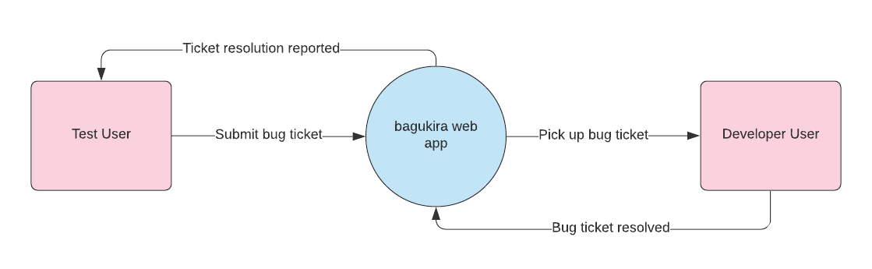
Data Flow Overview

Slide 4
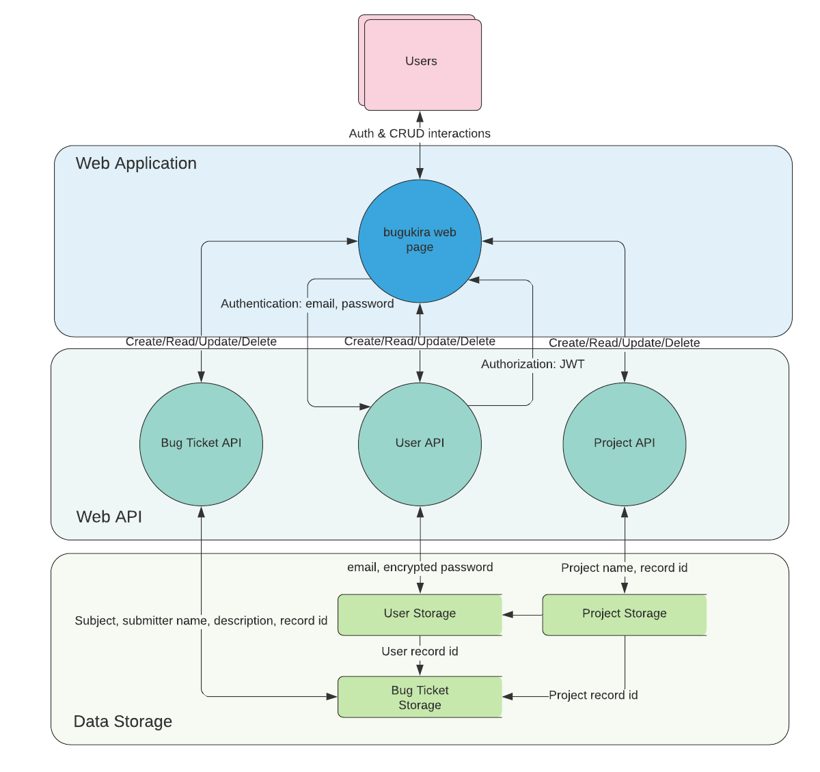
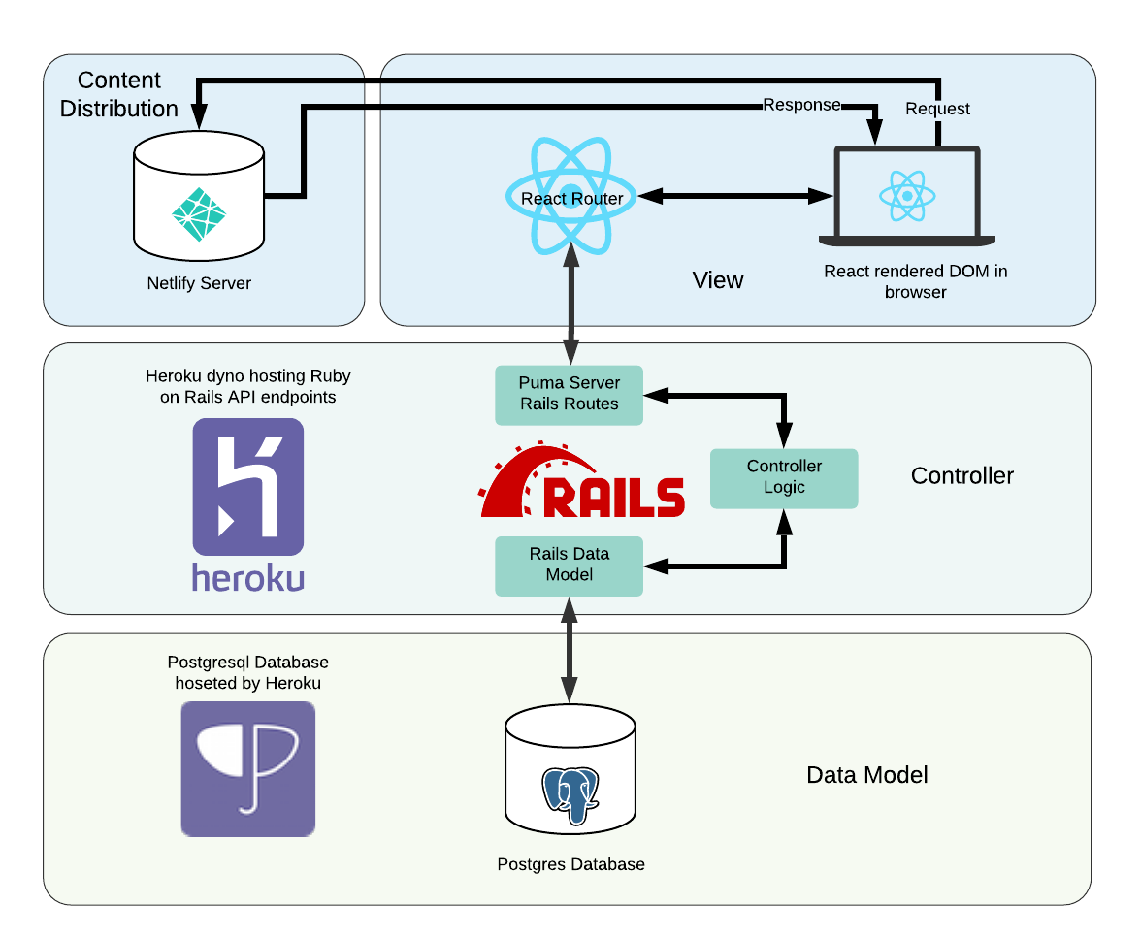

Slide 5
Wireframes
https://www.jakeiglasson.com/uploads/bagukira_wireframes.html

Slide 6
